Slide 1
Data Warehouse Optimization

Slide 2
Data warehouse queries and reports are essential for business intelligence, analytics, and decision making.
They can also be slow, expensive, and resource-intensive if not optimized properly.
We use indexing and partitioning techniques to improve the performance, scalability, and efficiency of data warehouse queries and reports.

Slide 3
Techniques
Indexing and partitioning work together to make data warehousing systems more efficient and responsive to queries, particularly in environments with large datasets and complex reporting requirements.
These techniques reduce the amount of data that needs to be processed and enhance parallelism, leading to better query performance.

Slide 4
Indexing
1. Data Retrieval:
Indexes are like data maps. They contain a sorted list of values from one or more columns and pointers to the actual data rows. When a query filters or joins data based on these indexed columns, the database engine can use the index to quickly locate the relevant rows.
Without indexes, the database would need to scan the entire table, which can be very slow for large tables.

Slide 5
Types of Indexes
Clustered Index:
This type of index determines the physical order of data rows within a table. It is often created on the primary key, and it speeds up data retrieval when queries involve range scans or sorting based on the primary key.
Non-clustered Index:
These indexes are separate data structures that contain the indexed columns and a pointer to the corresponding data row. Non-clustered indexes are used for speeding up query filtering and joins.

Slide 6
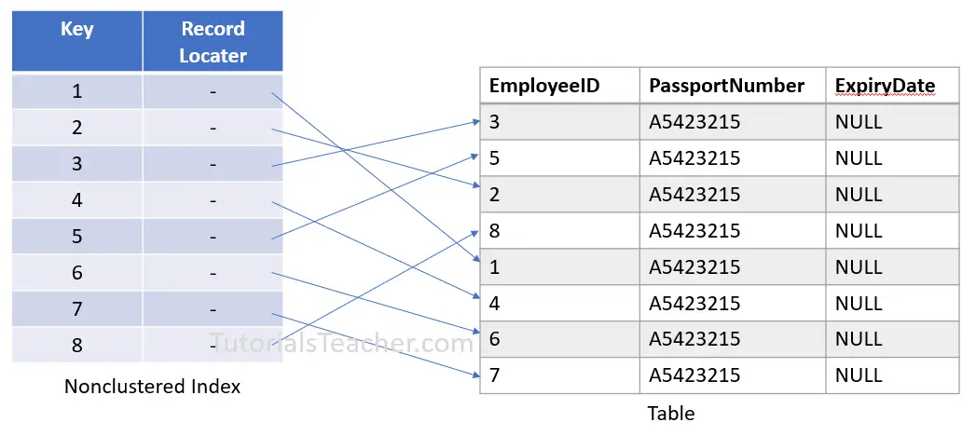

Slide 7
Index Maintenance:
Indexes need to be maintained when data is inserted, updated, or deleted. This maintenance can lead to some overhead in terms of write operations, but the benefits in terms of read query performance often outweigh this cost.

Slide 8
Partitioning
1. Data Division:
Partitioning divides a large table into smaller, more manageable units based on some criteria, such as date, region, or category. This reduces the amount of data that needs to be scanned, loaded, or moved for a query or a report.
2. Data Pruning:
When a query involves filtering based on the partitioning key (e.g., a specific date range), the database engine can "prune" the partitions not relevant to the query. This means that it only needs to scan a subset of the partitions, which greatly reduces the amount of data processed during query execution.

Slide 9
3. Parallel Processing:
Partitioned tables are well-suited for parallel processing. Each partition can be processed independently, potentially in parallel, by different CPU cores or database nodes. This parallelism can significantly speed up query execution, especially for large-scale data warehousing workloads.
4. Efficient Data Management:
Partitioning simplifies the management of data in the data warehouse. It makes it easier to add new data (e.g., data for a new month or year) to the table and also to archive or purge old data when it's no longer needed for regular reporting.

Slide 10
Combined Impact on Query Optimization
When you use indexing and partitioning together in a data warehouse:
Indexed columns can further optimize query filtering and joining.
Partitioning can efficiently manage the distribution and storage of data.
Pruning, parallel processing, and reduced data scanning make queries much faster and more efficient, particularly for large datasets.

Slide 11
Example
Consider a scenario in which you have a sales data table partitioned by date and indexed on product ID. When a user runs a query to retrieve sales for a specific product in a specific month, the database engine can quickly identify the relevant partition based on the date criteria. Within that partition, it can utilize the product ID index to find the desired product's sales data, resulting in a very efficient query execution

Slide 12
Advantages of Indexing & Partitioning
Indexing and partitioning can have several advantages for data warehouse queries and reports, such as faster query execution, lower storage and maintenance costs, and higher scalability and availability.
Indexes allow you to narrow down the search space, while partitions can be stored on different storage tiers depending on their usage frequency, performance requirements, and retention policies.
Partitions can also be distributed across multiple servers, nodes, or regions to increase capacity and resilience.
We can perform parallel operations on different partitions such as loading, updating, or aggregating data.

Slide 13
Indexing Process
1. Identify Key Columns: Determine which columns are frequently used for filtering, joining, or sorting in your queries. These are the columns that are good candidates for indexing. Common choices include primary keys, foreign keys, and columns used in WHERE clauses.
2. Choose the Right Index Type: Decide whether you need a clustered index, non-clustered index, or other specialized index types. A clustered index determines the physical order of data in the table, while non-clustered indexes are separate data structures. Choose the index type that best suits your data and query patterns.

Slide 14
Indexing Process (continue..)
3. Create Indexes:
Use SQL statements or a database management tool to create the indexes on the chosen columns. For example, in SQL Server, you can use a statement like `CREATE INDEX` to define an index.
4. Regularly Maintain Indexes:
Indexes require maintenance to remain effective. Monitor and maintain indexes by rebuilding or reorganizing them to ensure that they reflect the data accurately.

Slide 15
Partitioning Process
1. Define Partitioning Key:
Determine the criteria for partitioning your data. Common partitioning keys include date ranges, values (e.g., geographical regions, product categories), or a hash of a column. The choice should align with your query patterns and data distribution.
2. Create Partition Function:
Use SQL statements or a database management tool to create a partition function that defines the partitioning scheme. This function specifies how data will be divided into partitions based on the chosen key.

Slide 16
Partitioning Process (continue..)
3. Create Partition Scheme:
Create a partition scheme that maps the partitions defined by the partition function to filegroups (in case of SQL Server) or storage locations.
4. Implement Partitioned Tables:
For new tables, specify the partitioning scheme when creating the table. For existing tables, you may need to perform data migration to partition the data.

Slide 17
Partitioning Process (continue..)
5. Regularly Maintain Partitions:
As data continues to accumulate, manage partition maintenance activities, such as adding new partitions for future data, merging partitions if necessary, and archiving or purging old data partitions.

